Slide 1

IMAGE CAPTION GENERATOR
USING DEEP LEARNING
Under The Guidance of Presented By
Mrs. S.NAGAMANI M.Tech(Ph.D), M.APARNA
Assistant Professor, O180825
RGUKT-ONGOLE RGUKT-ONGOLE

Slide 2
What is Image Caption Generator?
Image caption generator is a task that involves computer vision and natural language processing concepts to recognize the context of an image and describe them in a natural language like English.

Slide 3
ABSTRACT:
Image Captioning is the process of generating captions with images as input. It provides the context of the image automatically. In this Python based project, we will have implemented the caption generator using CNN and LSTM . The image features will be extracted from Xception which is a CNN model trained on the dataset and then we feed the features into the LSTM model which will be responsible for generating the image captions.

Slide 4
EXISTING SYSTEM
In Image Caption Generator, captions are generated in a single line by using CNN-LSTM models
Single description generates low accuracy output
This Project used in small-scale Business Industry.
Generating captions with NLP which leads slower information transfer.

Slide 5
PROPOSED SYSTEM:
Development of automatically describing an image with more than natural language sentences which leads to faster information transfer.
Generating captions with large dataset.
Producing output with high accuracy.

Slide 6
REQUIREMENT SPECIFICATION
Hardware Requirements
• System: i3 Processor
• Hard Disk: 500 GB.
• Monitor: 15’’LED
• Input Devices: Keyboard, Mouse
• Ram: 4GB
Software Requirements
• Platform: Google Colab
• Coding Language: Python
• OS : Window / Linux

Slide 7
Technology Used To Build This Project:
NLTK
Python Libraries
Pickle
Dataset Imported through Kaggle APIs
RegEx
Tensor Flow
IMAGE CAPTION GENERATOR
Google Colab
matplotlib
NumPy
Python Libraries
Pandas
Keras

Slide 8
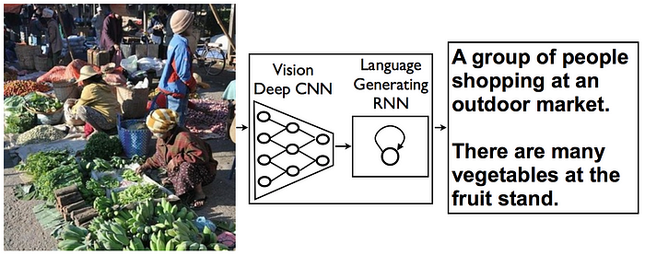
Image Caption Generator Model

Slide 9
WORKING EXPLANATION:
A user uploads an image that they want to generate a caption for.
A gray-scale image is processed through CNN to identify the objects.
CNN scans images left-right, and top-bottom, and extracts important image features.
By applying various layers like Convolutional, Pooling, Fully Connected, and thus using activation function, we successfully extracted features of every image.
It is then converted to LSTM.
Using the LSTM layer, we try to predict what the next word could be.
The application proceeds to generates a sentence describing the image.

Slide 10
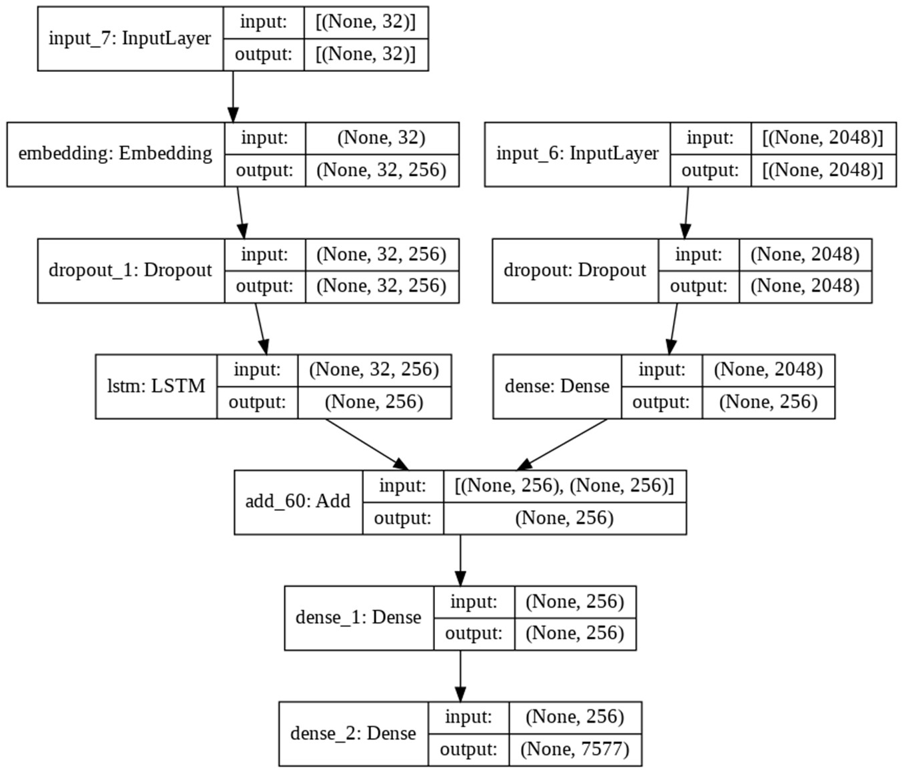
Visual representation of the Workflow model

Slide 11

Convolutional Neural networks are specialized deep neural networks which can process the data that has input shape like a 2D matrix. Images are easily represented as a 2D matrix and CNN is very useful in working with images.
What is CNN?

Slide 12
LSTM stands for Long short term memory, they are a type of RNN, which is
What is LSTM?
well suited for sequence prediction problems. LSTM can carry out relevant information throughout the processing of inputs and with a forget gate, it discards non-relevant information.

Slide 13
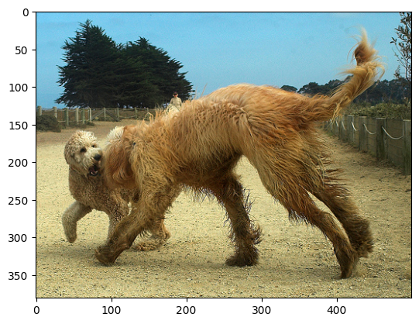
Result
1 -- huge brown dog is about to attack medium sized fluffy dog
2 -- very large brown dog is playing with smaller curly haired dog
3 -- dogs playing on the dirt path
4 -- two dogs chase one another on gravel road
5 -- two wet dogs

Slide 14
FUTURE SCOPE:
In future scope, we will use modules like stopwords and Torch to Implementing UI for this Project.
We can use this in image indexing, for visually impaired persons, for social media,
and several other natural language processing applications.
generating audio for the randomly occurring captions.
I'd like to train our model on a larger dataset with a greater number of photographs in the future. The captions generated should be in a range of languages.
Larger datasets and alternative CNN architectures, such as LeNet, AlexNet, GoogLeNet, ResNet, and others, were used to train and evaluate the model.

Slide 15
CONCLUSION:
Image caption generator is a task that involves computer vision and natural language processing concepts to recognize the context of an image and describe them in a natural language like English. So, to make an image caption generator model, we have merged these architectures. It is also called a CNN-RNN model.
CNN is used for extracting features from the image. We will use the pre-trained model Xception.
LSTM will use the information from CNN to help generate a description of the image.

Slide 16


